Slide 1
Tweets topic modeling with
Latent Dirichlet Allocation
JISU QIAN & RUNSHI YANG

Slide 2
Problem Description and Motivation
Can use unsupervised learning methods to discover some natural topics given a large quantity of tweets?
Why topic modeling?
We are too lazy to label tweets by ourselves 👀
Have collections of documents,
but not sure what we’re looking for,
divide them into natural groups so that we can understand them separately.

Slide 3
Data Discription
Tweepy
use “oil” as search word
filter out retweets
set tweet_mode to “extended”
number of observations: 6360

Slide 4
Preprocessing
Tokenization
Remove urls, special characters, punctuations and stop words
Change into lower case
Lemmatization
Vectorization

Slide 5
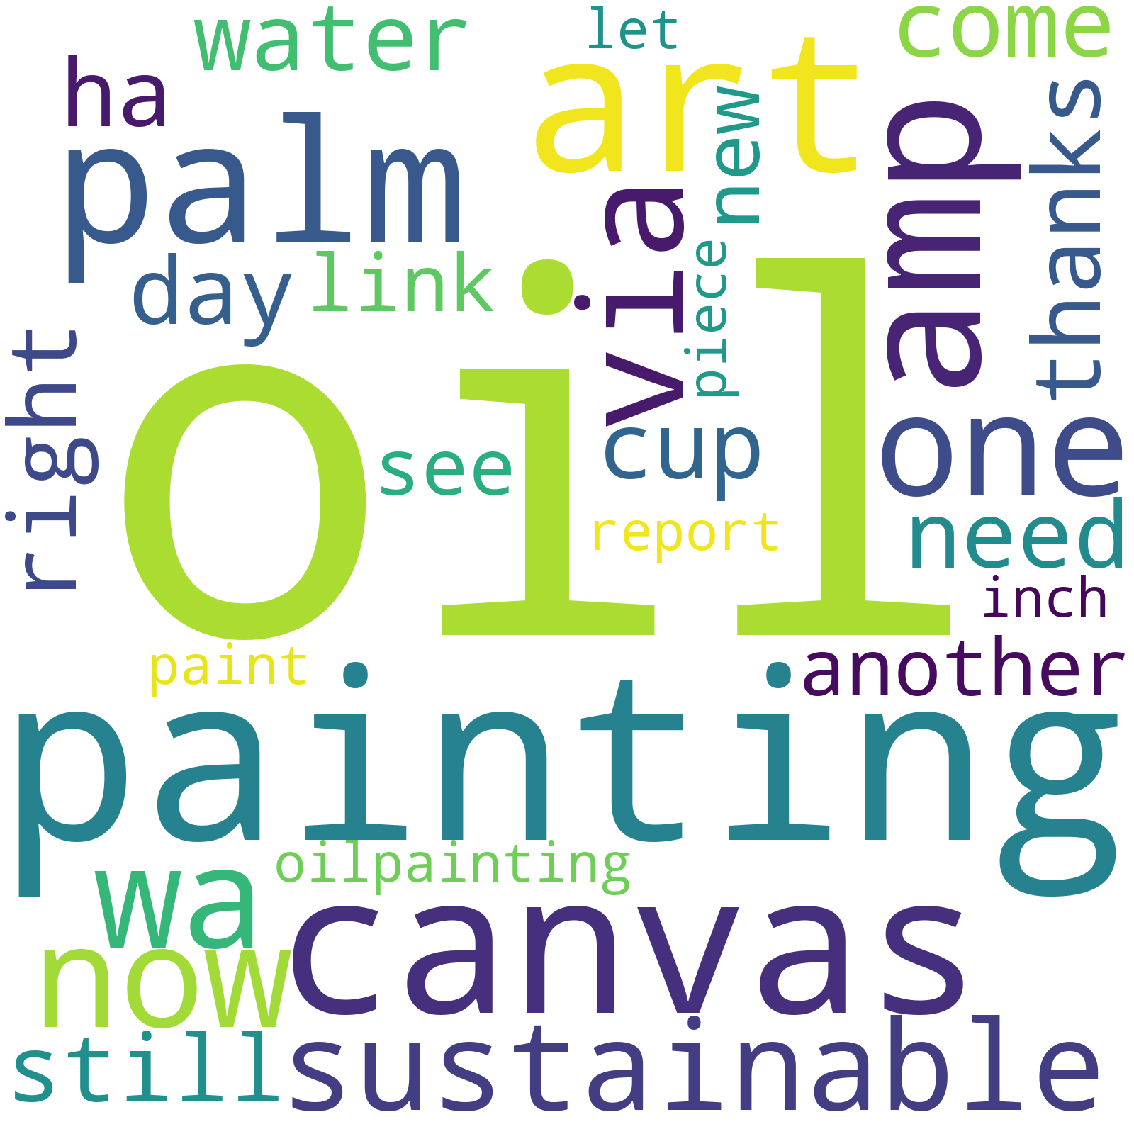
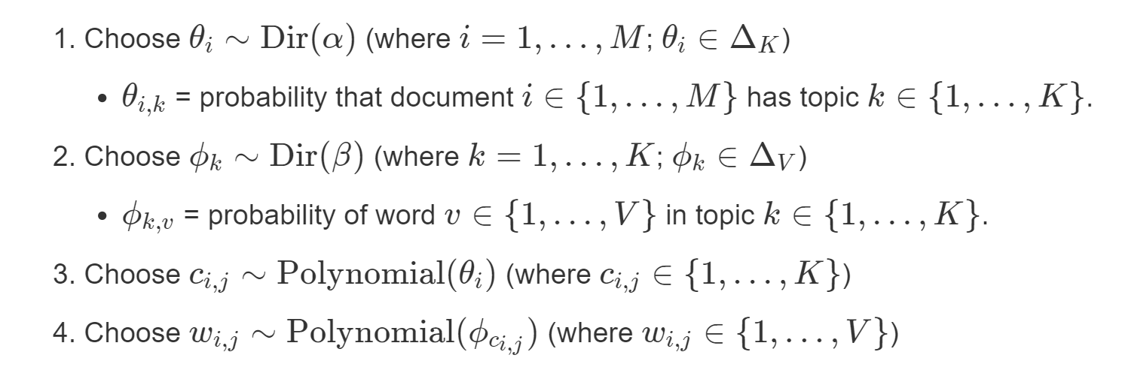
Model: Latent Dirichlet Allocation
Every document is a mixture of topics.
Every topic is a mixture of words.

Slide 6
Results
DEMO

Slide 7
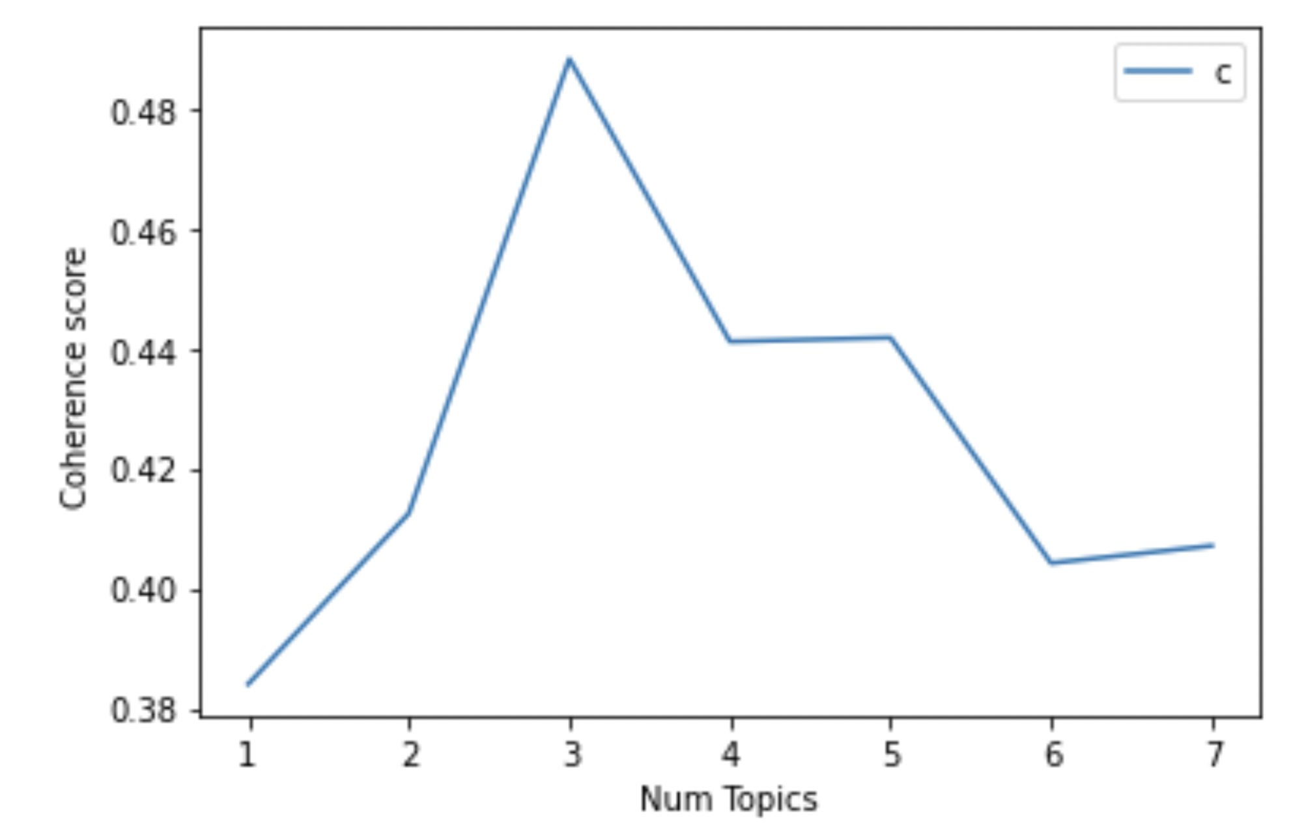
Evaluation
coherence score
c_v coherence score

Slide 8
Thank You
Questions?

